Slide 1


Theory of Computation: A Problem-Solving Approach
Chapter – 6: Nature of Regular Languages

Slide 2
Learning Objectives
Learn to combine regular languages using their closure properties to obtain more complex regular languages.
Learn to answer questions such as emptiness and finiteness of regular languages.
Learn why some languages are not regular.
Learn why regular languages are called regular.
Learn to apply the Pumping Lemma in an adversarial game to show that some languages are not regular.

Slide 3
Regular Languages
Regular languages correspond to
a deterministic finite automaton (DFA), or
a non-deterministic finite automaton (NFA), or
a regular expression (RegEx), or
a right-linear grammar or a left-linear grammar (regular grammar)

Slide 4
Closure Properties of Regular Languages
Regular languages are closed under:
Union
Concatenation
* Closure
Complementation
Reversal
Intersection
Difference
Homomorphism

Slide 5
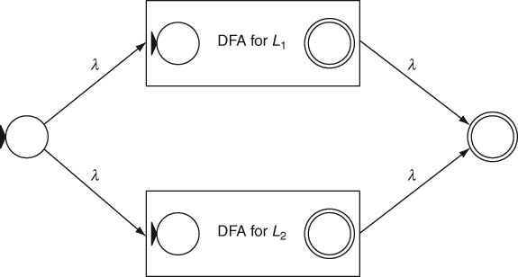
Union of Regular Languages
The union of two regular languages is a regular language.
NFA for the union of two regular languages:

Slide 6

Concatenation of Regular Languages
The concatenation of two regular languages is a regular language.
NFA for the concatenation of two regular languages:

Slide 7
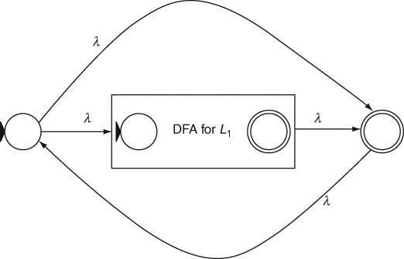
* Closure of a Regular Language
The * closure of a regular language is a regular language.
NFA for the * closure of a regular language:

Slide 8
Complement, Reversal and Intersection
The complement of a regular language is a regular language
Because we can interchange final and non-final states of a DFA to obtain a DFA for the complement.
The reversal of a regular language is a regular language
Because we can reverse the direction of every transition and then adjust start and final states suitably to obtain a DFA for the reversed language.
The intersection of two regular languages is a regular language
Because of the set theoretic relations between complement, union and intersection: L₁ ∩ L₂ = (L₁.Complement ∪ L₂.Complement).Complement
The difference of two regular languages is a regular language
Because of the set theoretic relations between complement, difference and intersection: L₁ – L₂ = L₁ ∩ L₂.Complement
Homomorphism is replacing symbols in strings with new symbols

Slide 9
Using Closure Properties: Example 6.1
Given a regular language L, L.L^{R} – the language L concatenated with its reverse L^{R} – is a regular language.
Regular languages are closed under both reversing and concatenation. Therefore this is true.
However, this is not the same as the language of even palindromes – strings that read the same left-to-right and right-to-left, where the second half of every string is the reverse of the first half of the same string. This includes all strings in the given language concatenated with the reverses of themselves as well as any other strings in the language.
E.g., L = {abc, bbb}, then L.L^{R} = {abccba, abcbbb, bbbcba, bbbbbb}

Slide 10
Answering Regular Language Questions
Is a given regular language empty?
empty there is no path from the start state of its DFA to any accepting state, or if it has no RegEx or if the start symbol S in its grammar does not derive any terminal string
Is a given regular language finite or Infinite?
finite if its automaton is acyclic
its machine must still be finite even if the language is infinite;
the machine for any infinite language must have a loop in it, that is, any software program (that is necessarily finite) must have at least one loop if it must be able to process an infinite language – an infinite variety of inputs; and
all finite languages are regular
Does a given string w belong to a regular language L? (membership question)
If the automaton accepts the string
Are two regular languages the same? (see Chapter 4)

Slide 11
Pigeonhole Principle
Pigeonhole Principle says that only n things at most can fit into n slots or holes or bins.
If there are n pigeonholes in a building, each big enough for just one pigeon to sit in, then at most n pigeons can sit in the pigeonholes.
If the (n+1)th pigeon comes flying in, it will not be able to find a hole to sit in. There is no way that more than n pigeons can be accommodated in n pigeon holes.
We use this to show that some languages are not regular
using the Pumping Lemma for regular languages

Slide 12
Pumping Lemma for Regular Languages
In plain English:
Regular languages are regular because every non-trivial string in every infinite regular language has a repeating pattern that is not empty and is not too far from the beginning of the string; this pattern can be repeated any number of times to generate infinitely many strings in the language.
Formally:
Every infinite regular language L has a constant m, specific to that language, such that all strings w, |w| ≥ m belonging to L can be split into w = xyz where |xy| ≤ m and |y| ≥ 1 and for all i = 0, 1, 2, … the strings xy^{i}z belong to L.

Slide 13
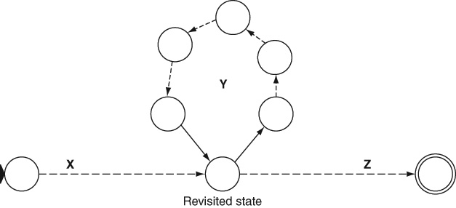
Pumping Lemma: Why is it True?
There must be a loop that represents the repeating pattern in the language

Slide 14
Using Pumping Lemma: Adversarial Game
How to choose a proper string w?
Since we don't know what m is, and since w must be at least as long as m, the string we choose must somehow contain m in its expression.
Our objective is to gain total control of what goes into the parts x and y; to do this, we need to ensure that the first part is at least as long as m and we need to put whatever symbol or pattern is convenient to us in the first part.
We need to control the boundary between the first part that is in our control and the second part that is not; in particular, we do not want to allow the opponent (see Table 6.1 below) to choose a symmetrical y (e.g., ab) that can cross the boundaries between the two parts to ensure symmetry or correlation and thereby prevent any contradiction from occurring; and
We need to establish a contradiction by creating an imbalance between the first part that is in our control and the second part (which should not change when we pump y).

Slide 15
Using Pumping Lemma: Adversarial Game
The Pumping Lemma alternates between universal and existential quantification:
For all infinite regular languages,
There exists a constant m that is specific to that language, such that
For all strings w longer than m in the language,
There exists a partition of w into xyz, such that
y is not empty and xy is not longer than m and
For all values of i,
y can be pumped up or down i times to generate an infinite number of strings all of which belong to the regular language.

Slide 16
Using Pumping Lemma: Adversarial Game
The lemma is true for all regular languages and, therefore, we can assume that a particular language is regular and apply the Pumping Lemma to it.
The lemma is true for only some value of the constant m for that language and thus the value of m remains unknown to us; we cannot arbitrarily choose m = 100 for example.
The lemma is true for all strings w that are longer than m and therefore we are free to choose whichever string is convenient to us, as long as it belongs to the language.
The lemma is true for some partitioning of w into xyz; we don’t know which one it is and we cannot partition the string to our convenience; for example, we cannot say let x be null.
The lemma is true for all values of i and, therefore, it is sufficient for us to show that one particular value of i (say 0 or 2) results in a string that does not belong to the language, thereby establishing the contradiction.

Slide 17
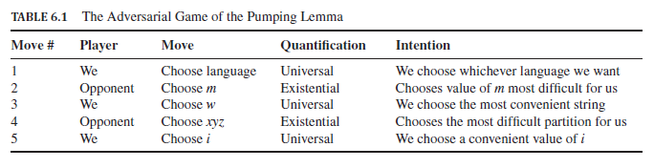
The Adversarial Game

Slide 18
Pumping Lemma: Example 6.2
Simple Nesting language: a^{n}b^{n} is not regular
Proof by contradiction: Let it be regular.
Choose w = a^{m}b^{m}
y has only a s
Pumping results in mismatched strings that do not belong to the language
This is a contradiction
Therefore the simple nesting language is not regular.

Slide 19
Pumping Lemma: Examples 6.3, 6.4, 6.5
Example 6.3: The language of even palindromes is not regular.
Choose w = a^{m}bba^{m}
Example 6.4: The language ww is not regular
Choose w = a^{m}ba^{m}b
Example 6.5: Unary addition is not a regular language
a^{p}b^{q}c^{r} where r = p + q
Choose w = a^{m}b^{m}c^{2m}

Slide 20
Theorems
Theorem 7: Closure properties of Regular Languages: Regular languages are closed under union, concatenation, *-closure, complementation, reversal, intersection, set-difference and homomorphism.
Theorem 8: Decidability of Questions about Regular Languages: Algorithms exist for determining whether a given regular language is empty, finite or infinite; whether a string belongs to a regular language; and whether two regular languages are the same.
Theorem 9: Pumping lemma for Regular Languages: Every infinite regular language L has a constant m, specific to that language, such that all strings w, |w| ≥ m belonging to L can be split into w = xyz where |xy| ≤ m and |y| ≥ 1 and for all i = 0, 1, 2, … the strings xy^{i}z belong to L.
Theorem 10: Myhill-Nerode Theorem: A language L is regular if and only if the equivalence relation of distinguishing extensions on strings in the language has a finite number of equivalence classes.

Slide 21
Key Ideas
Regular languages are well-behaved under various operations. They can easily be combined using union, concatenation, * closure, complementation, reversal, intersection and set difference operations.
A regular language is empty if there is no path in any automaton for the language from its start state to any accepting state. It is also empty if in any equivalent regular grammar, the start symbol S is non-generating.
A regular language is finite if there is no loop in its finite automaton along any path from the start state to any accepting state. A corresponding regular expression has no * closure and the corresponding regular grammar has no recursive production rule or cycle among any of its non-terminals. Any software program that is able to handle an unlimited variety of inputs must have at least one loop (or an equivalent recursive function) in it.
Every finite language is regular.
All infinite regular languages have a repeating pattern that is not too far from the beginning of its strings.

Slide 22
Key Ideas (contd..)
The repeating pattern can be repeated any number of times to generate an infinite set of strings each of which must belong to the regular language. This is called the Pumping Lemma.
The Pumping Lemma is used only to show that a given language is not regular in a proof by contradiction.
The Pumping Lemma is used in an adversarial game where the opponent chooses an unknown value for the constant m and an unknown partition of the string w into xyz. We can choose the string w and the value of i to our convenience.
Application of the Pumping Lemma works like an adversarial game because of alternating universal and existential quantifiers. We are free to choose any value when a variable is universally quantified but must ensure that our arguments work for any unknown value when under an existential quantifier.
The key to a successful application of the Pumping Lemma is to choose a string that includes the constant m and takes full control over the crucial substring of length m.

Slide 23
End of Chapter 6

